Slide 1
How to create a Common Module?
European Initiative for the exchange of young officers inspired by Erasmus
The Initiative
Erasmus
Militaire
Military
Erasmus
EMILYO

Slide 2
Aim of the Train the Trainers’ Workshop
Explain:
What is a “Common Module”?
Why do we need them?
Guidelines
for establishing a Common Module

Slide 3
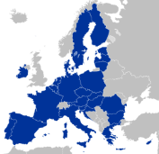
Common Module What is it?
Request comments
from 65 BOEI (or MOD)
Proposed Module
Cultural
Awareness
(2 ECTS)
Proposed Module
Electronic
Warfare
(2 ECTS)
Proposed Module
Fighting in
Build-Up Areas
(3 ECTS)
IG + LoD 8 Chairmen
pre-check:
Strategy
Goal-correctness
Learning Outcomes acc. to LoD 2
ECTS correctness (law, regulations)
Strategic Partnership
Implementation Group
BOEI Representatives
~ 80 Education
Experts
5 BOE
Institutions
Experts from
BOEI & MOD
Implemen-
tation
(national
Curricula)
Regular
adjustment(s)
see:
http://www.emilyo.eu/node/988
Approved
Common Module
XXXX
(X ECTS)
External Evaluation?
Internal Quality
Assurance System

Slide 4
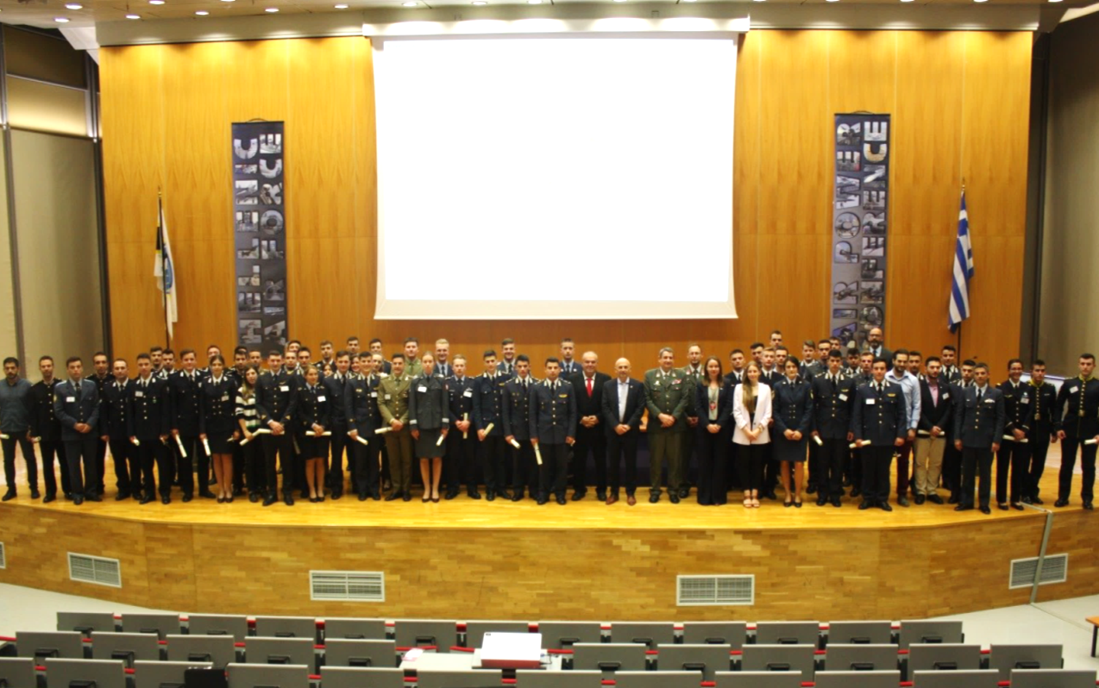
Common Module Which ones are existing?
Common Module | ECTS |  | Common Module | ECTS
Advanced Technologies in Borders Surveillance | 2 |  | Individual Personal Development and Meta-Communication | 2
Aviation English for ICAO LPR | 3 |  | Interoperability | 6
Aviation English P1 | 3 |  | Irregular Warfare | 3
Aviation English P2 | 3 |  | Law of Armed Conflict | 2
Basic Military English | 2 |  | Leadership & Agility in Complex Environments | 2
Battle Physical, Mental and Survival Training | 3 |  | Leadership in Communication - IMLA | 2
Biosafety and Bioterrorism | 2 |  | Leadership, Motivation and Influence - IMLA | 2
Budget & Finance in EU Defence | 2 |  | Maritime Leadership | 2
Close Quarter Battle | 3 |  | Maritime Security | 2
Common Operating Environment | 3 |  | Military Ethics (A) | 2
Common Security and Defence Policy | 2 |  | Military Ethics (B) | 2
Comprehensive Approach | 4 |  | Military Instructor Training | 3
CMO/PSO (4 Sub-Modules [A, B, C, D]) | 12 |  | Military Leadership (A) | 2
Crisis Management (Military Leadership) – IMLA | 2 |  | Military Leadership (B) | 2
Cross Cultural Communication | 2 |  | Military Leadership (C) | 4
CSDP-Olympiad | 2 |  | Military Strategy and Security in the Baltic Sea Region | 3
Cultural Awareness | 2 |  | Senior Cadets’ Seminar on Leadership | 1.5
Cyber Security | 2 |  | Small Unit Tactics | 4
Defence and Security Economics | 4 |  | Social Engineering Protection | 2
Digital Leadership | 3 |  | Space Applications for Security and Defence | 2
Electronic Warfare | 2 |  | Stress Management - IMLA | 2
English for Aircraft Maintenance SET P1 | 3 |  | Troop Leading Procedures | 1
English for Aircraft Maintenance SET P2 | 3 |  | Technologies in Cyber Security | 2
English for Aircraft Maintenance SET P3 | 3 |  | Unmanned Aerial Systems | 2
English for Aviation Security Personnel | 3 |  | Winter Warfare Basic Module | 2
Fighting In Built Up Area | 3 |  | (NCM/Intern) Aerospace Technology (PL / MUT) | 6
How to meet the Media | 2 |  | Total: 52 | 139.5

Slide 5
Common Module Why do we need them?
Official mandate for the Implementation Group: “Harmonisation of the EU basic officer education”
Practical: Facilitates exchanges
Approved
Common Module
XXXX
(2 ECTS)
Country “A”
Country “B”
Implementation
into national Curriculum
or international offer on case-by-case basis
Implementation
into national Curriculum
or international offer on case-by-case basis
Identical ECTS;
Identical learning outcomes
Identical ECTS;
Identical learning outcomes
2 ECTS, achieved learning outcomes,
⬅ recognition is no problem!

Slide 6
Steps for the Creation of a Common Module
Step 1 / Question 1: Is the overall content important for all EU Cadets / Midshipmen?
All Services
Army
Air Force
Navy
Technical
Medical
Others, e.g.: Military Force charged with Police Duties
Do not initiate / create a Common Module …
just to increase the reputation of your national curriculum;
just to increase the attractiveness of a national module for international exchanges;
just to solve national administration problems.

Slide 7
Steps for the Creation of a Common Module
Step 2 / Question 2: What is the goal of the future Common Module?
Describe the goal(s) of a future Common Module …
in a broad general statement;
without verbs;
do not go too much into details ➔ details are described in the learning outcomes;
do not list too many goals.
Example for a future Common Module on Gender Mainstreaming:
Basic gender concepts.
International policy regarding gender issues.
Impact of gender issues on leadership.

Slide 8
Steps for the Creation of a Common Module
Step 3 / Question 3: Is such a Common Module already existing?
Compare your goal(s) with existing Common Modules
all module descriptions are available at: http://www.emilyo.eu/node/988;
if there is a need for revision – based on e.g. outdated contents – provide a proposal to the IG (first IG chairman and LoD2 and LoD8 chairpersons);
we should not “re-invent the wheel”.

Slide 9
Steps for the Creation of a Common Module
Step 4 / Question 4: Which are the learning outcomes?
Describe the learning outcomes …
divide them into knowledge, skills and competences ➔ (responsibility and autonomy);
describe them according to the SQF MILOF descriptors;
do not use more than 6 learning outcomes (in total) per module;
think always, how to evaluate each part of the learning outcomes ➔ if not possible, delete them / re-formulate them!
check back if you are in line with the module’s goal(s);
Link to presentation by LoD2 chairperson

Slide 10
Steps for the Creation of a Common Module (LOs)
Example for a future Common Module on Gender Mainstreaming:
Determined goals: Basic gender concepts / International policy regarding gender issues / Impact of gender issues on leadership.
 |  | Description | Evaluation
Learning Outcomes | Know- ledge | Describe the basic gender concepts of UN, EU and NATO. List the main approaches of international policy regarding gender issues. | Written test
 | Skills | Identify gender issues for the integration into the mission analyses. Explain the necessity of specific gender issues on tactical level. | Provide different scenarios and let cadets/midshipmen do the mission analyses. Create an evaluation paper for that. Provide scenarios on tactical level and cadets/midshipmen give orders to subordinates (focus on gender issues). Create an evaluation paper for that.
 | Respon- sibility & Auto- nomy | Infer the needs for different gender issues or policies. | Cadets/midshipmen are to establish a 2-pages seminar paper. Create an evaluation paper for that. Take into consideration the time for the papers’ evaluation – on the module’s last day the evaluation must be provided.

Slide 11
Steps for the Creation of a Common Module
Step 5 / Question 5: Which pre-conditions for participation are needed?
Because of different education systems in Europe …
which language is to be used (the only success is the offer in English) ➔ normal procedure: CEFR “B1”;
which duration of national education is needed ➔ normal procedure: sophomore and higher;
is there any e-learning necessary prior to the residential phase to assure the same entrance level (take the new Erasmus+ funding for students into consideration);
do I have to create to create e-learning or is it available (e.g. AKUs from ESDC) ➔ see: http://www.emilyo.eu/node/978

Slide 12
Steps for the Creation of a Common Module
Step 6 / Question 6: Which lecture units are needed?
Describe the lecture units with their necessary time…
not too much details (course director’s freedom of movement);
but as detailed as necessary to assure equal learning outcomes.
Example for a future Common Module on Gender Mainstreaming:
Module Details
Main Topic | Recom- mended WH | Details
Lectures: Basic gender concepts of UN, EU and NATO. | 3 | Main aspects of the UNSCR 1325. EU gender equality strategy 2020-2025. CWINF Guidance for NATO Gender Mainstreaming.
Lecture: International policy regarding gender issues | 1 | International Global Policy on Gender Equality and Inclusion.
MAPEX: Integration of gender issues into mission analyses. | 4 | Four different scenarios reaching from peace-time to robust operations. Practical mission analyses with focus on gender aspects. Cadets/midshipmen give a presentation.

Slide 13
Steps for the Creation of a Common Module
Step 7 / Question 7: Which is the total amount of needed working hours (WH)?
Add together …
the amount of WHs for e-learning in advance (just in case, e-learning is foreseen);
the amount of WHs for the residential phase (just those hours, which the cadets/midshipmen are present in the lecture room or are doing/learning something with lecturers/instructors).
Example for a future Common Module on Gender Mainstreaming:
E-learning prior to the residential phase: 8 WHs
Residential lectures (incl. MAPEXs, etc.): 17 WHs
In total: 25 WHs

Slide 14
Steps for the Creation of a Common Module
Step 8 / Question 8: How many ECTS can be issued according to the Bologna Process?
According to the Bologna Process …
1 ECTS equals a workload of 25 - 30 WHs for the student;
also according to national laws / regulations for HE.
1 ECTS | Residential (incl. e-learning in advance) | Tutorials | Self-studies
Percentage | 30 - 40% | 10 - 20% | 40 - 60%
Working Hours (WHs) | 7.5 - 12 | 2.5 - 6 | 10 - 18
Lecture Units (45 min) | 10 - 16 | 3.3 - 8 | 13.3 - 24

Slide 15
Steps for the Creation of a Common Module
1 ECTS | Residential (incl. e-learning in advance) | Tutorials | Self-studies
Percentage | 30 - 40% | 10 - 20% | 40 - 60%
Working Hours (WHs) | 7.5 - 12 | 2.5 - 6 | 10 - 18
Lecture Units (45 min) | 10 - 16 | 3.3 - 8 | 13.3 - 24
Example for a future Common Module on Gender Mainstreaming:
In total: 25 WHs
25 WHs equal 2 ECTS (probably reduce 1 WH?)
2 ECTS can be organised in 1 week (ideal approach)
5 - 12 WHs are foreseen for tutorials (individual lectures)
20 - 36 WHs are to foresee for self-studies!

Slide 16
Steps for the Creation of a Common Module
Step 9 / Question 9: Should the future Common Module be integrated into the academic or non-academic part?
If academic …
take the WHs as described in step 8;
If non-academic …
the workload is not expressed in ECTS, but in WHs (e.g.: 90 WH [valid for 3 ECTS]);
self-study hours may be shifted to the residential (more practical) part.

Slide 17
Steps for the Creation of a Common Module
Step 10 / Question 10: Which name the future Common Module should have?
Find an attractive (“sexy”) name for the future Common Module;
the name should express with few words the “philosophy” of the future Common Module.
Example for a future Common Module on Gender Mainstreaming:
“Gender mainstreaming for Leaders”

Slide 18
Steps for the Creation of a Common Module
Step 11 / Question 11: Which education the teachers / instructors should have?
According to the needs for all or for specific topics …
describe the English level they should have;
describe the teaching experience they should have;
describe specific needs (specific studies, experience, specialisations, etc.).
Example for a future Common Module on Gender Mainstreaming:
English: Common European Framework of Reference for Languages (CEFR) Level B2 or NATO STANAG Level 3.
Teaching experience on at least Bachelor-level.
Expert concerning specific lecture units of the module.

Slide 19
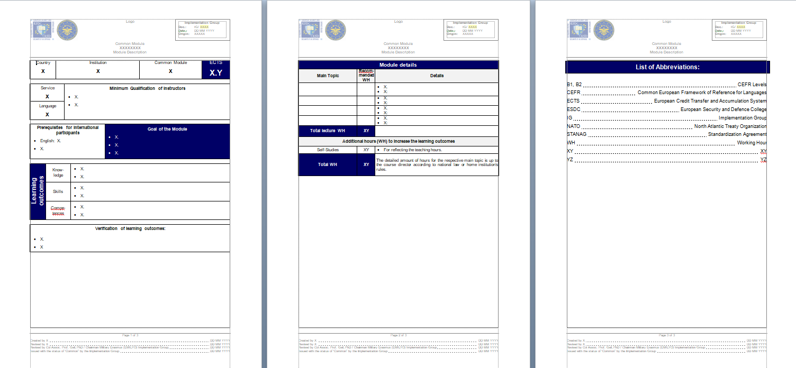
Steps for the Creation of a Common Module
Step 12: Integrate your elaborations into the Common Module’s template. (http://www.emilyo.eu/node/182)

Slide 20
Steps for the Creation of a Common Module
Step 13 / Question 13: Which abbreviations are used within the entire document?
List all abbreviations …
on the last page of the module description;
integrate all abbreviations (also those ones of the headers, footnotes, etc.);
use the format of the module description.

Slide 21
Steps for the Creation of a Common Module
Step 14: Send the description of the future Common Module to the IG Chairman, to the LoD2 and LoD8 chairpersons and to the ESDC TM.
Before sending…
integrate everything according to the template;
format the document according to the template;
integrate the name of the responsible person in the footnote;
make a proper grammar- and spell-check according to British English.

Slide 22
Steps for the Creation of a Common Module
Step 15 / Question 15: Is it possible to issue ECTS Grades during the Common Module?
According to the Bologna-Process (and according to ERASMUS+) …
students should receive ECTS-grades;
ECTS-grades are not just a transfer of the national grades;
ECTS-grades request a certain calculation;
it would be useful that segments of the evaluation (e.g.: test(s), observations, presentations, etc.) are evaluated with the same amount of points;
Link to the calculation paper.

Slide 23
thank YOU
for YOUR
attention!

